Slide 1
Object Orientation in Java
www.cybage.com
Copyright © 2019 Cybage Software Pvt. Ltd. All Rights Reserved. Cybage Confidential. www.cybage.com

Slide 2
Agenda
Procedural Vs OOP
Object Characteristics
Major Pillars of OOPS
Inheritance and Polymorphism
Abstract Class and Interface
Object Class
Lambda Expression
www.cybage.com

Slide 3
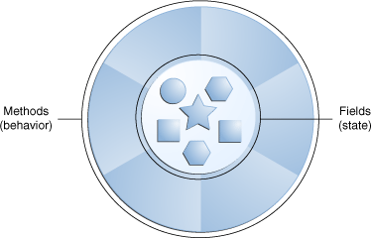
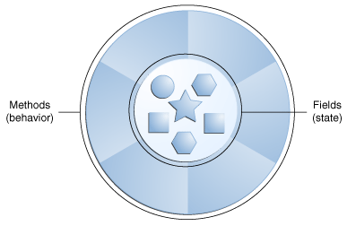
Procedural VS OOP
Procedural Languages
Object Oriented Language
Data
Methods
Separated
Data
Methods
www.cybage.com

Slide 4
Object Characteristics
State
Behavior
Identity
Responsibility
www.cybage.com

Slide 5
State
State: Current values of the parameters
State can be either static or dynamic
Example: | CAR
Static state Color Make Model |  | Dynamic state Speed Fuel Level Tyre pressure
www.cybage.com

Slide 6
Behavior
How the object acts and reacts with respect to state changes.
Example: Bank Account withdraw()
deposit()
It will change the “balance” (i.e. Dynamic state of Account object)
www.cybage.com

Slide 7
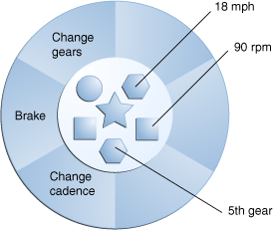
Representation of static & dynamic state & behavior of a bicycle
State and Behavior
www.cybage.com

Slide 8
Identity
That property which uniquely distinguishes the entity from all other entities
Example: Car -- RTO / registration no
www.cybage.com

Slide 9
Responsibility
Responsibility:
The very purpose or the role that entity serves in the system
Example :
Bank account : To enable to carry out money transactions Car : To take the rider from one place to another
www.cybage.com

Slide 10
Major Pillars of OOPS
Abstraction
Encapsulation
Inheritance
Polymorphism
www.cybage.com

Slide 11
Abstraction
Selective negligence
Process of identifying the key aspects and concentrating on them
by ignoring the rest (Ignore that what is insignificant to you)
Abstraction of a Person
as an Employee Name age | as a Patient Name age | as a Student Name age
Educational Qualification | ------ | -------
------- | blood group | ------
------- | Medical history | ------
------- | -------- | batch
Abstraction of same entity will be different for different users
www.cybage.com

Slide 12
Encapsulation
Software objects are conceptually similar to real-world objects
they too consist of state and related behavior.
An object stores its state in fields and exposes its behavior through
methods.
Methods operate on an object's internal state and serve as the primary
mechanism for object-to-object communication.
Hiding internal state and requiring all interaction to be performed through an object's methods is known as data encapsulation — a fundamental principle of object-oriented programming.
www.cybage.com

Slide 13
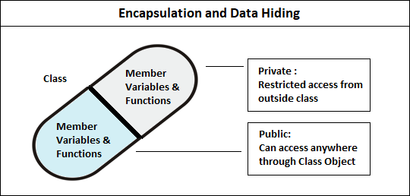
Encapsulation Contd..
www.cybage.com

Slide 14
Inheritance
Inheritance : “Is-a” -type of relationship
Properties of parent are inherited in child.
Properties of Vehicle are inherited in a four wheeler & a two wheeler In addition, a
four wheeler can have its own properties specific to it.
As we go from parent to child we are moving from generic to specific.
& from child to parent : From specialization to generalization
Advantage : Reusability
Another advantage : Inheritance builds foundation for dynamic
www.cybage.com

Slide 15
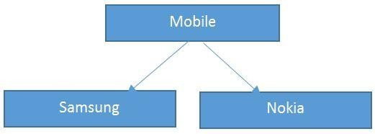
Inheritance Contd..
Inheritance is the capability of a class to use the properties and methods of another class while adding its own functionality.
Java uses the "extends“ keyword to set the relationship between a parent class and a child class.
www.cybage.com

Slide 16
Inheritance Contd..
Inheritance is the capability of a class to use the properties and methods of another class while adding its own functionality.
Java uses the extends keyword to set the relationship between a parent class and a child class.
www.cybage.com

Slide 17
Super Keyword
The keyword super is used in a class to refer to its superclass.
It can refer to both data attributes and methods of super class
A subclass method may invoke a super class method using the super
keyword
www.cybage.com

Slide 18
Invoking Super Class Constructor
When a subclass object is created, constructor gets called in the order from Super to sub.
If there is an explicit call to super class constructor from sub
class constructor then that call should be the first statement
class Car extends Vehicle { public Car (int now){
super(now);
}
}
www.cybage.com

Slide 19
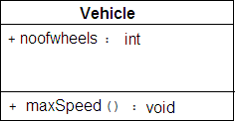
Subclassing
The Vehicle class is as follows public class Vehicle{
public int noofwheels; public void maxSpeed(){
}
}
www.cybage.com

Slide 20
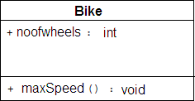
Subclassing Contd...
The Bike class is as follows public class Bike{
public int noofwheels;
public void maxSpeed(){
}
}
www.cybage.com

Slide 21
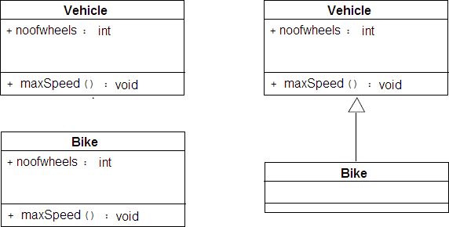
Class diagram of Vehicle and Bike without and with inheritence
Class Diagram
www.cybage.com

Slide 22
Polymorphism
Polymorphism: One message and different responses
Example:
Traffic signal goes Red – single message :- to Stop car will stop in its own way
scooter will stop in its own way bicycle will stop in its own way
This type of behavior is called as polymorphic behavior
In Software Programming, polymorphism is achieved in two ways
method overloading
method overriding
•
•
Polymorphism helps in writing more maintainable & extensible code.
www.cybage.com

Slide 23
Polymorphism
Polymorphism (one message & different responses):
- It involves one method name with no.of different
implementations
The method call is resolved to appropriate method implementation
Polymorphism can be achieved in two ways: method overloading & method overriding
Polymorphism helps to desgin & implement systems which are
more easily extensible & maintainable
www.cybage.com

Slide 24
Types of Polymorphism
The two types of polymorphism :
Static Polymorphism also known as Compile time polymorphism
Dynamic Polymorphism also known as Run time polymorphism
www.cybage.com

Slide 25
Static Polymorphism
Function Overloading is an example of static polymorphism.
Overloaded methods have same name but different method signatures. (Method signature may vary in 3 ways)
Example:
public class Mclass
{
public void add(int x){} public
The m• ethod call is resolved to suitable method implementation at compile time .
(compiler searches for matching function signature)
void add(int x , int y){}
public void add(int x, float y){}
public void add(float x, int y){}
}
www.cybage.com

Slide 26
Dynamic Polymorphism
Dynamic polymorphism is achieved through method Overriding
Overriding is directly related to Sub -classing
Method is said to be overridden when a subclass modifies the
behavior of superclass method to suit its requirement.
The new method definition must have the same method signature (i.e., method name and parameters) and return type should also match.
www.cybage.com

Slide 27
Dynamic Polymorphism Contd..
class Vehicle
{
public void showSpeedRange()
{ System.out.println(“No range specified”)}
}
class Car extends Vehicle
{
public void showSpeedRange()
{ System.out.println(“Range: 0-300 ”)}
}
class Bike extends Vehicle
{
public void showSpeedRange()
{ System.out.println(“Range: 0-120 ”)}
www.cybage.com

Slide 28
Dynamic Polymorphism Contd..
class SpeedDemo
{
public static void main(String args[])
{
Vehicle v[] = { new Car() ,new Bike(),new Car}
for(int i=0; i< v.length; i++)
v[i].shoeSpeedRange();
}
}
Static data type of v[i] is vehicle & dynamic data type is either Car or Bike. Here Dynamic Data Type will govern the method selection…. So its dynamic polymorphism.
www.cybage.com

Slide 29
Abstract Class
Method calArea() can not be implemented in Shape class.
Class Shape
p v calcualteArea()
Such a method which is declared but not defined is called an abstract method
So class Shape must be declared as abstract & Class Shape should not be instantiated
Class Triangle
extends
p vcalcualteArea(){}
ClassCircle
extends
p vcalcualteArea(){}
Class Hexagon
extends
p vcalcualteArea(){}
Implementation of calArea() can be provided in subclasses i.e. Triangle , Circle, Hexagon
calArea() can be implemented in each subclass i.e. Traingle,Circle, Hexagon
www.cybage.com

Slide 30
Abstract Class
Java Abstract classes are used to declare common characteristics of subclasses.
Abstract classes are used to provide a template or design for concrete subclasses down the inheritance tree.
Abstract classes are declared with the abstract keyword.
One or more methods in an abstract class are declared but not defined.
www.cybage.com

Slide 31
Abstract Class Continued..
Any class containing even a single method as abstract must be declared as abstract
An abstract class may contain concrete methods as well.
An abstract class can not be instantiated
Sub class of an abstract class must implement all abstract methods of super class or it must also be declared as abstract
Constructors & static methods can not be declared as abstract
www.cybage.com

Slide 32
Interface
interface Printable
{
public void print()
}
an interface is a reference type, similar to a class, that can contain only
constants & method signatures
There are no method bodies inside an interface
Interfaces cannot be instantiated
www.cybage.com

Slide 33
Interface
Methods declared in an interface are by default abstract
Variables declared in an interface are by default
public ,static & final
Interfaces help to club non-related classes under one roof
Interfaces provide support for multiple inheritance in Java. (They
support dynamic polymorphism but there is no code reusability)
Interfaces are some times known as “Programming by contract”. A class that implements the interface is bound to implement all the methods defined in Interface.
Interfaces provide ‘Lose Coupling’
www.cybage.com

Slide 34
Interface
If a class that implements an interface does not define
All the methods of the interface, then it must be declared abstract and the method definitions must be provided by the subclass that extends the abstract class.
The interface without any method declaration (empty interface) is called as Marker or Tagging interface.
Ex: Serializable,Cloneable.
www.cybage.com

Slide 35
Abstract Class Vs Interface
Abstract Classes
“Is a” type relationship exists between abstract super class & subclass extending it
Can contain implemented
methods as well
subclass can not extend from more than one abstract class
Interfaces
Interfaces are used to club together Non related classes
Can contain only abstract
methods
A class can implement no. of interfaces
www.cybage.com

Slide 36
Object Class
Object class is a cosmic super class
Object class is the ultimate ancestor
Every class in java implicitly extends Object
www.cybage.com

Slide 37
Object Class Methods
toString()
clone()
equals(Object o)
wait()
hashCode()
notify()
finalize()
notifyAll()
www.cybage.com

Slide 38
toString()
public String toString()
Override this method to represent your class objects textually. class Date
{
public String toString()
{
return (“The date is”+ dd+”,”+mm+”,”+ yy);
}
}
www.cybage.com

Slide 39
finalize()
Garbage collector generally reclaims orphaned object spaces
finalize() gets exceuted just before an object is garbage collected
Override this method to write clean up code
www.cybage.com

Slide 40
equals()
equals() method tests objects for equality.
As implemented in Object class, it checks whether two references point
to same memory location or not.
Override this method when you want to compare two objects for equality based on their contents (& not on memory location).
www.cybage.com

Slide 41
hashCode()
int hashCode()
As implemented in object class, this method returns memory representation of the object in decimal format.
It is recommended that whenever you override equals(), override hashCode() as well. (….WHY?)
www.cybage.com

Slide 42
Lambda Expression
Lambda expressions basically express instances of functional interfaces.
An interface with single abstract method is called functional interface example is java.lang.Runnable
Enable to treat functionality as a method argument, or code as data
A function that can be created without belonging to any class
A lambda expression can be passed around as if it was an object and executed on
demand.
www.cybage.com

Slide 43
Lambda Expression
interface FuncInterface { void abstractFun(int x); default void normalFun() { System.out.println("Hello"); } } | class Test{ public static void main(String args[]) { FuncInterface fobj = (int x)->System.out.println(2*x); fobj.abstractFun(5); } }
www.cybage.com

Slide 44
Lambda Expression
Zero Parameter () -> System.out.println("Zero parameter lambda");
One Parameter (p) -> System.out.println("One parameter: " + p);
Multiple Parameters (p1, p2) -> System.out.println("Multiple parameters: " + p1 + ", " + p2);
www.cybage.com

Slide 45

www.cybage.com

Slide 46



Thank You!
www.cybage.com
Copyright © 2019 Cybage Software Pvt. Ltd. All Rights Reserved. Cybage Confidential._{5/12/2021} www.cybage.com 47

